Slide 1

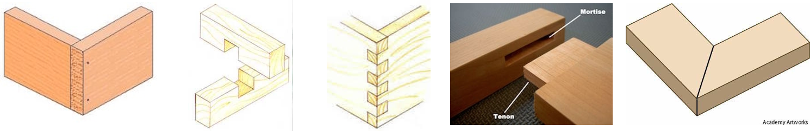
Types of Joints
Score each joint for the following - identify 3 favourites
Aesthetics /10
Surface Area /10
Mechanical strength /10
Difficulty to construct /10
DESIGN
Butt Joint
Cross halving joint
Finger joint
Mortise & tenon joint
Mitre joint
 | 5.25/10 | 7/10 | 8/10 | 6.75/10 | 4.75/10
Aesthetics | 7 | 8 | 9 | 8 | 7
Surface Area | 6 | 6 | 7 | 7 | 6
Mechanical strength | 5 | 7 | 8 | 6 | 4
Difficulty to construct | 3 | 7 | 8 | 6 | 2

Slide 2
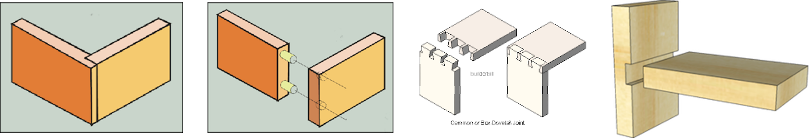
Types of Joints
Score each joint for the following
Aesthetics /10
Surface Area /10
Mechanical strength /10
Difficulty to construct /10
DESIGN
Lap Joint
Dowel joint
Dovetail joint
Housing joint
 | 3.75/10 | 6.5/10 | 8.25/10 | 4.75/10
Aesthetics | 5 | 7 | 9 | 6
Surface Area | 5 | 7 | 7 | 6
Mechanical strength | 2 | 5 | 8 | 4
Difficulty to construct | 3 | 7 | 9 | 3

Slide 3
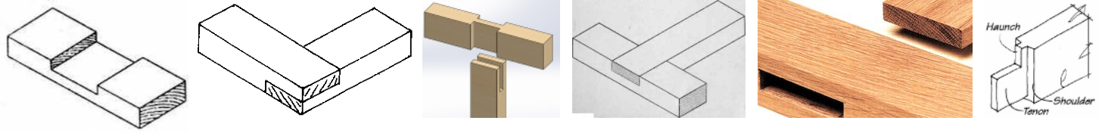
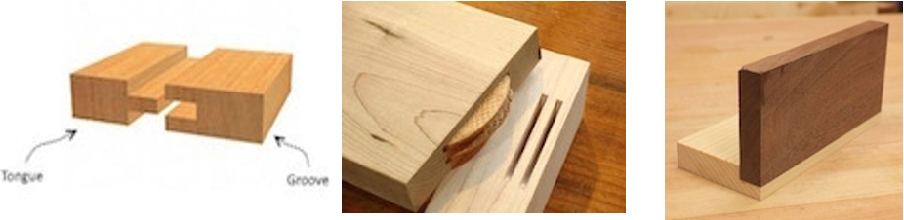
Types of Joints
Joint Terminology – Random questions found in exams
Halving
Corner
Bridle
DESIGN
Tee
Through Vs Blind
Tongue and Groove
Biscuit Joint
Rebate

Slide 4
Types of Joints
Task: Using a range of scrap materials, by hand, create as many joints as possible! Be accurate with measurements and quality of the joint model
Housing Joint
DESIGN
Finger joint
Cross halving joint
Lap Joint
Mortise & tenon joint
Which techniques and skills might be useful?
How do you create them?
What is the best modelling material for each?

Slide 5
Types of Joints
Task: Add photos of your joining tests - add notes
Finger joint
Lap Joint
Mortise & tenon joint
DESIGN
Which techniques and skills might be useful?
What is the best modelling material for each?
Cross halving joint
Housing Joint
How do you create them?

